Slide 1

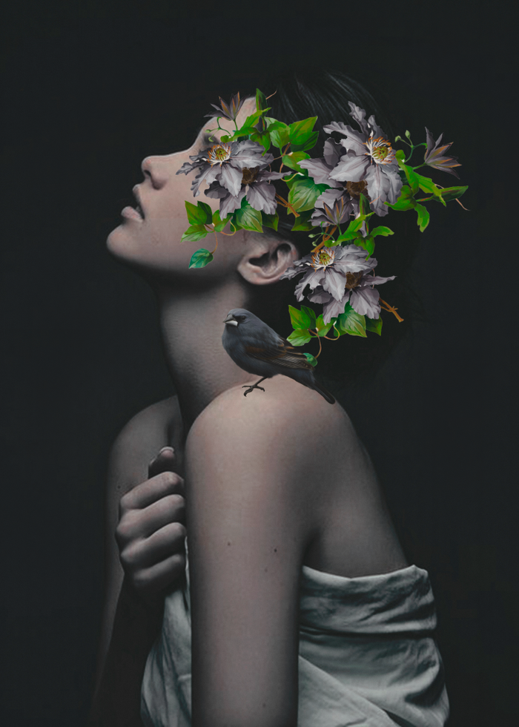
Retro style
优雅复古画册风PPT模板
A designer can use default text to simulate what text would look like. If it is not real text. A designer can use default text to simulate what text would look like.

Slide 2
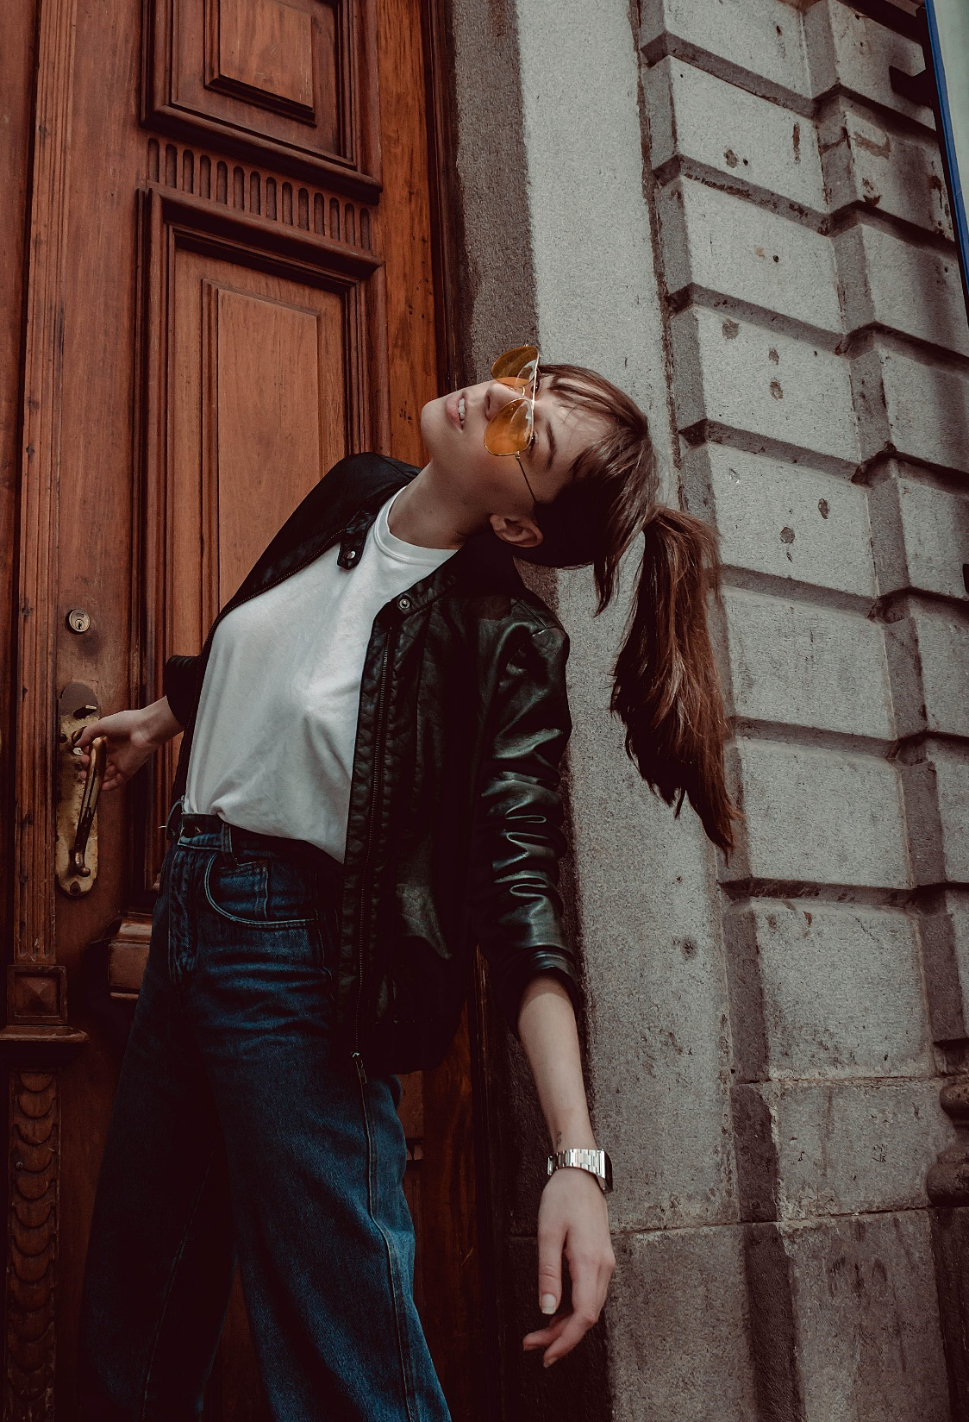
RETRO STYLE
A designer can use default text to simulate what text would look like. If it is not real text.
A designer can use default text to simulate what text would look like. If it is not real text. A designer can use default text to simulate what text would look like.

Slide 3

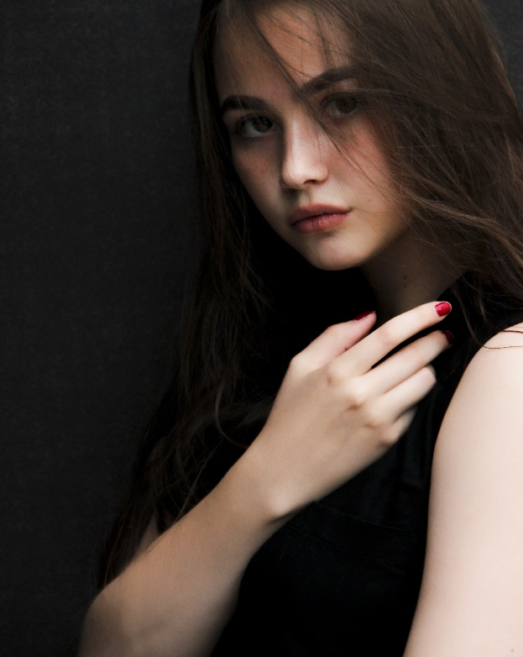
RETRO STYLE
A designer can use default text to simulate what text would look like. If it is not real text.
A designer can use default text to simulate what text would look like. If it is not real text. A designer can use default text to simulate what text would look like.

Slide 4

RETRO STYLE
A designer can use default text to simulate what text would look like. If it is not real text. A designer can use default text to simulate what text would look like. A designer can use default text to simulate what text would look like. If it is not real text. A designer can use default text to simulate what text would look like.

Slide 5

A designer can use default text to simulate what text would look like. If it is not real text.
RETRO STYLE
A designer can use default text to simulate what text would look like. If it is not real text. A designer can use default text to simulate what text would look like.

Slide 6

A designer can use default text to simulate what text would look like. If it is not real text. A designer can use default text to simulate what text would look like. A designer can use default text to simulate what text would look like. If it is not real text. A designer can use default text to simulate what text would look like.
01
A designer can use default text to simulate what text would look like. If it is not real text.
VOGUE
02
A designer can use default text to simulate what text would look like. If it is not real text.

Slide 7
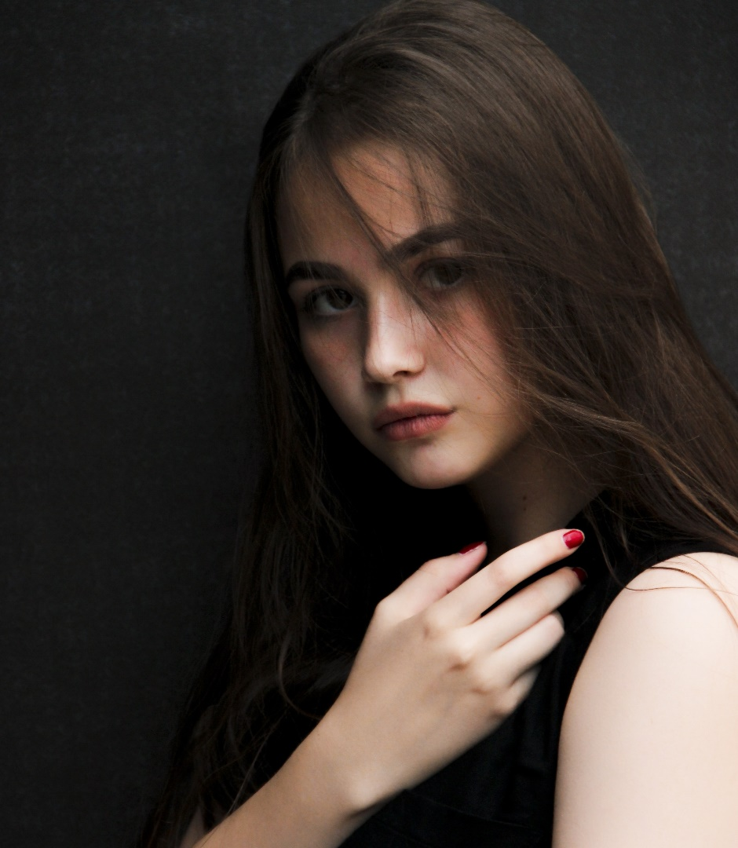
RETRO STYLE
A designer can use default text to simulate what text would look like. If it is not real text. A designer can use default text to simulate what text would look like.

Slide 8

RETRO STYLE
A designer can use default text to simulate what text would look like. If it is not real text.
A designer can use default text to simulate what text would look like. If it is not real text. A designer can use default text to simulate what text would look like. A designer can use default text to simulate what text would look like. If it is not real text. A designer can use default text to simulate what text would look like.

Slide 9


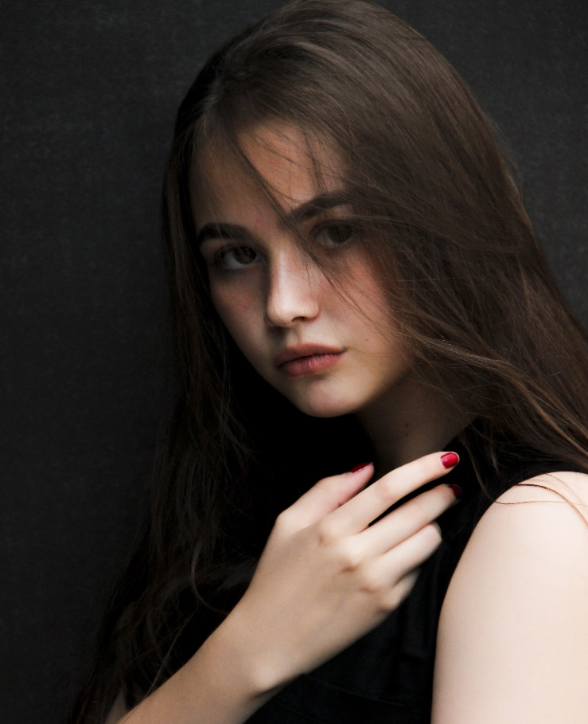

RETRO STYLE
A designer can use default text to simulate what text would look like. If it is not real text. A designer can use default text to simulate what text would look like. A designer can use default text to simulate what text would look like.

Slide 10

RETRO STYLE
A designer can use default text to simulate what text would look like. If it is not real text. A designer can use default text to simulate what text would look like.

Slide 11

01
A designer can use default text to simulate what text would look like. If it is not real text.
02
A designer can use default text to simulate what text would look like. If it is not real text.
03
A designer can use default text to simulate what text would look like. If it is not real text.
RETRO STYLE

Slide 12

A designer can use default text to simulate what text would look like. If it is not real text. A designer can use default text to simulate what text would look like. A designer can use default text to simulate what text would look like.
RETRO STYLE
01
A designer can use default text to simulate what text would look like. If it is not real text.
02
A designer can use default text to simulate what text would look like. If it is not real text.

Slide 13
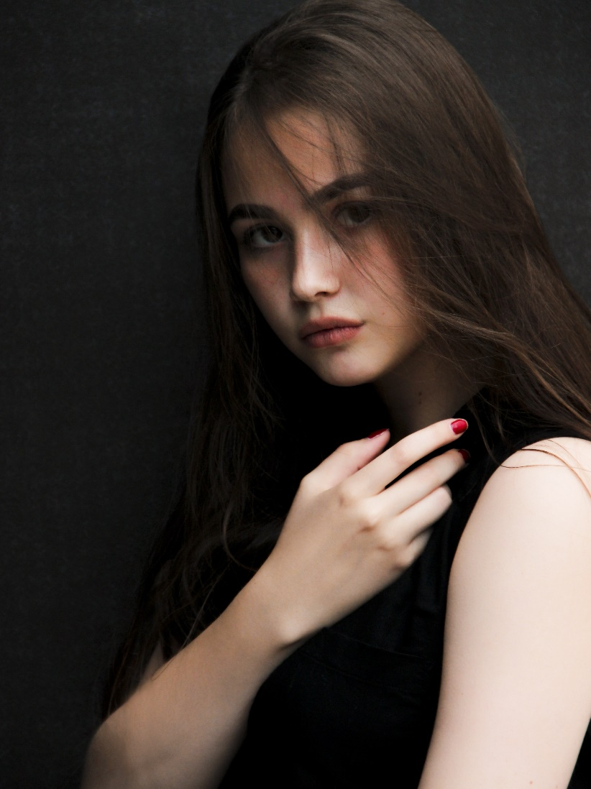
RETRO STYLE
OUR LOVE MEMORY
A designer can use default text to simulate what text would look like. If it is not real text. A designer can use default text to simulate what text would look like. A designer can use default text to simulate what text would look like. If it is not real text. A designer can use default text to simulate what text would look like.

Slide 14

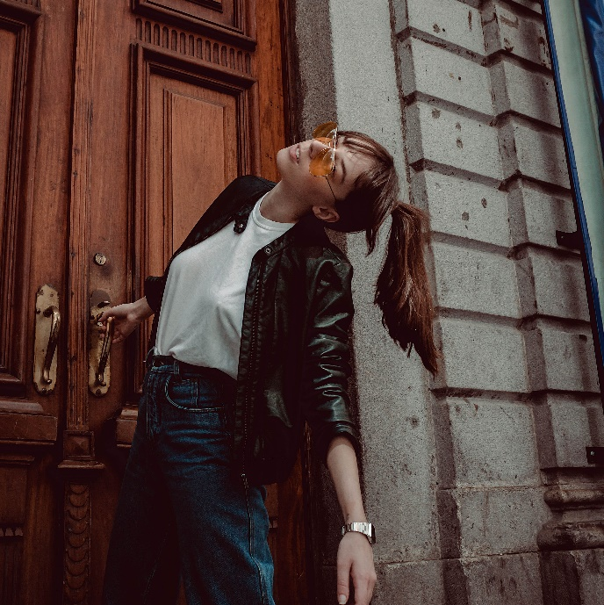


RETRO STYLE
A designer can use default text to simulate what text would look like. If it is not real text. A designer can use default text to simulate what text would look like. A designer can use default text to simulate what text would look like. If it is not real text.

Slide 15
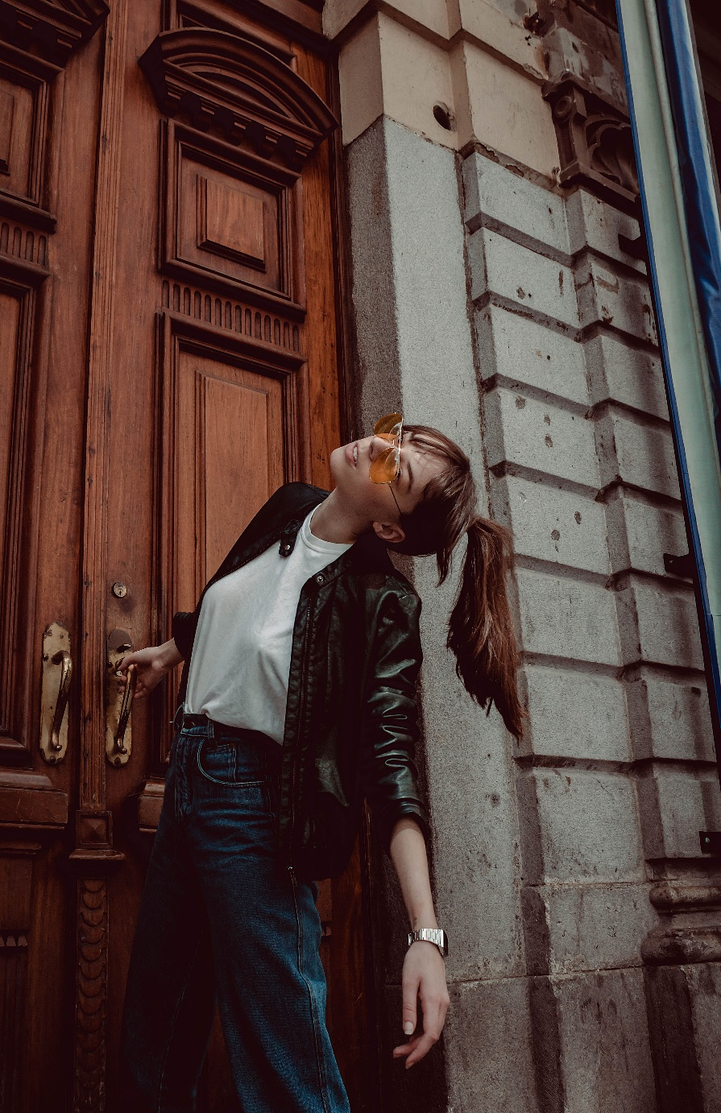
RETRO STYLE
A designer can use default text to simulate what text would look like. If it is not real text. A designer can use default text to simulate what text would look like. A designer can use default text to simulate what text would look like. If it is not real text. A designer can use default text to simulate what text would look like.

Slide 16
优雅复古画册风PPT模板
A designer can use default text to simulate what text would look like. If it is not real text. A designer can use default text to simulate what text would look like.

